Slide 1
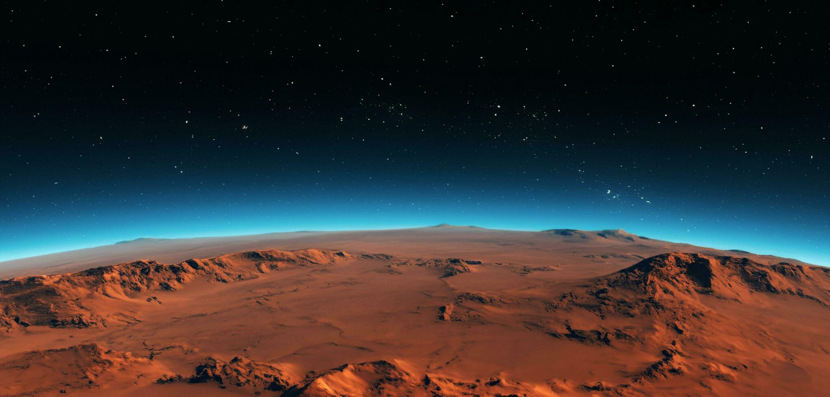




Investigating the cause of Mars’ large volcanoes from deep mantle convection
Mentor: Dr. Mingming Li | AZ Space Grant Symposium | April 20, 2024
Presented By: Ritisha Das

Slide 2
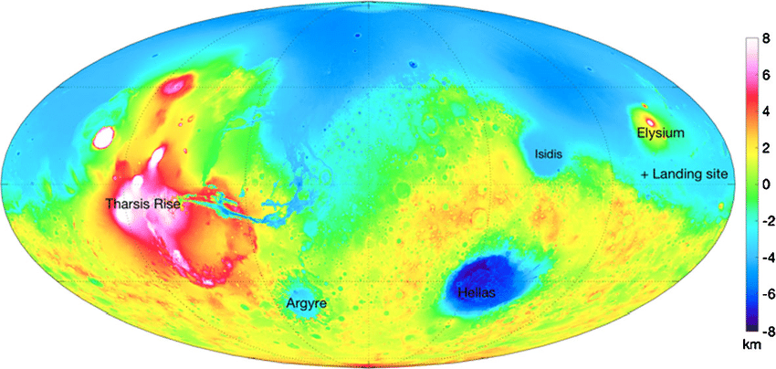
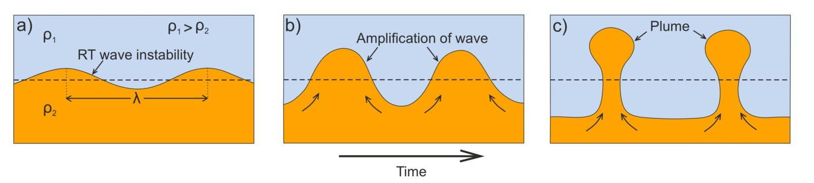
Introduction
Topographically, Mars exhibits crustal dichotomy
Large temperature difference between Mars’ mantle and core forms hot convecting thermal boundary layer (TBL)
1 large mantle plume formed – Mars’ superplume, the largest volcano in the Solar System
Plume formation depends on rheology and initial temperatures of the core and mantle [1].
Rayleigh Taylor Instability: impact of heavy fluid pushing lighter fluid
Source: Space Science Reviews
Source: Jadavpur University Geodynamics

Slide 3
Motivation
  Analyzing Mars’ surface will help to better understand:
  Realism and possibility of life on Mars
  Planetary evolution
  Parallels with evolution of Earth
  Seismological information about Mars

Slide 4
Objective
Question: In a simulated numerical model, what conditions will yield a single mantle plume on Mars and model Mars’ mantle convection most accurately?
Explore how different initial mantle temperatures affect the development, size, formation and properties of mantle plumes
Answer how Mars’ internal processes evolve with time and affect the surface
Use computer simulations in CitcomS
Analyze observational data about Mars’ internal structures from the geophysical InSight mission

Slide 5
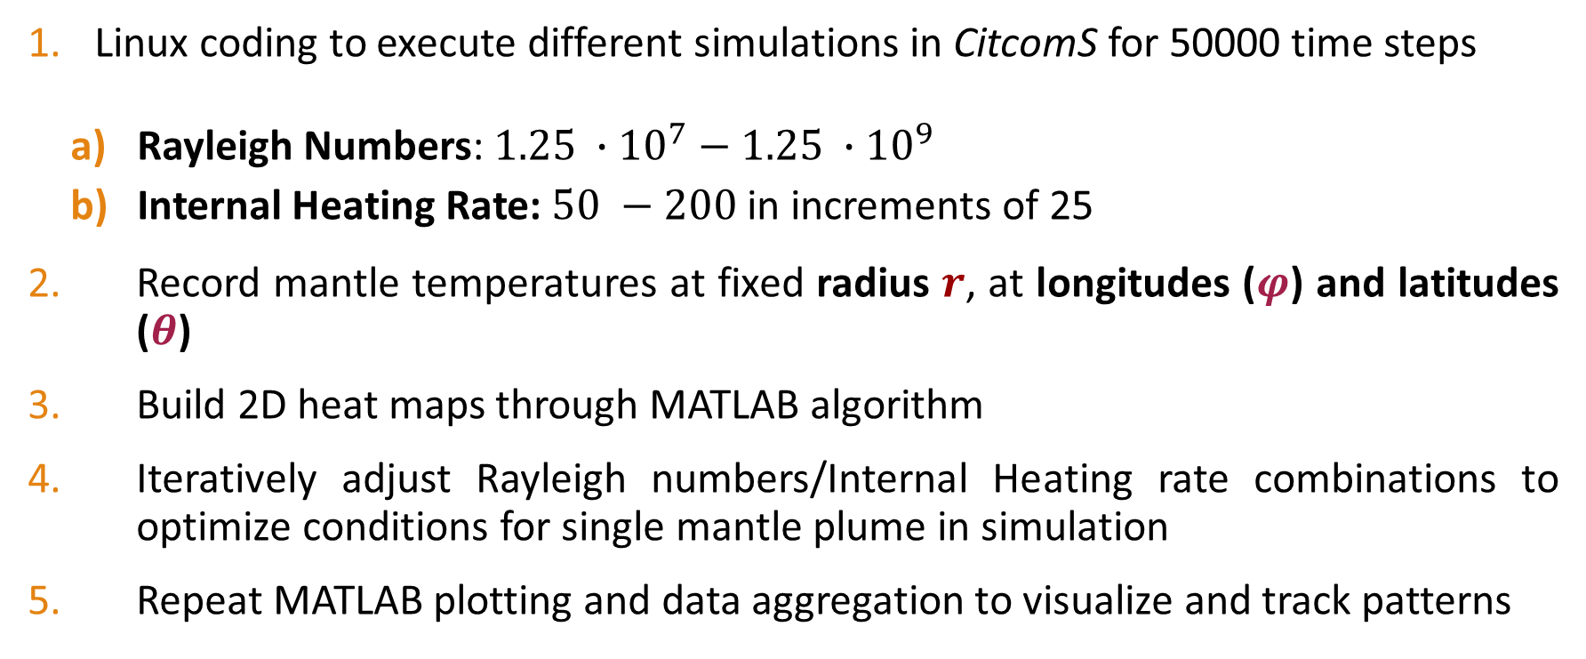
Methodology
Linux coding to execute different simulations in CitcomS for 50000 time steps
  Rayleigh Numbers: $1.25 ∙{10}^{7}−$ $1.25 ∙{10}^{9}$
  Internal Heating Rate: $50 −200$ in increments of 25
Record mantle temperatures at fixed radius $r$, at longitudes ($φ$) and latitudes ($θ$)
Build 2D heat maps through MATLAB algorithm
Iteratively adjust Rayleigh numbers/Internal Heating rate combinations to optimize conditions for single mantle plume in simulation
Repeat MATLAB plotting and data aggregation to visualize and track patterns

Slide 6
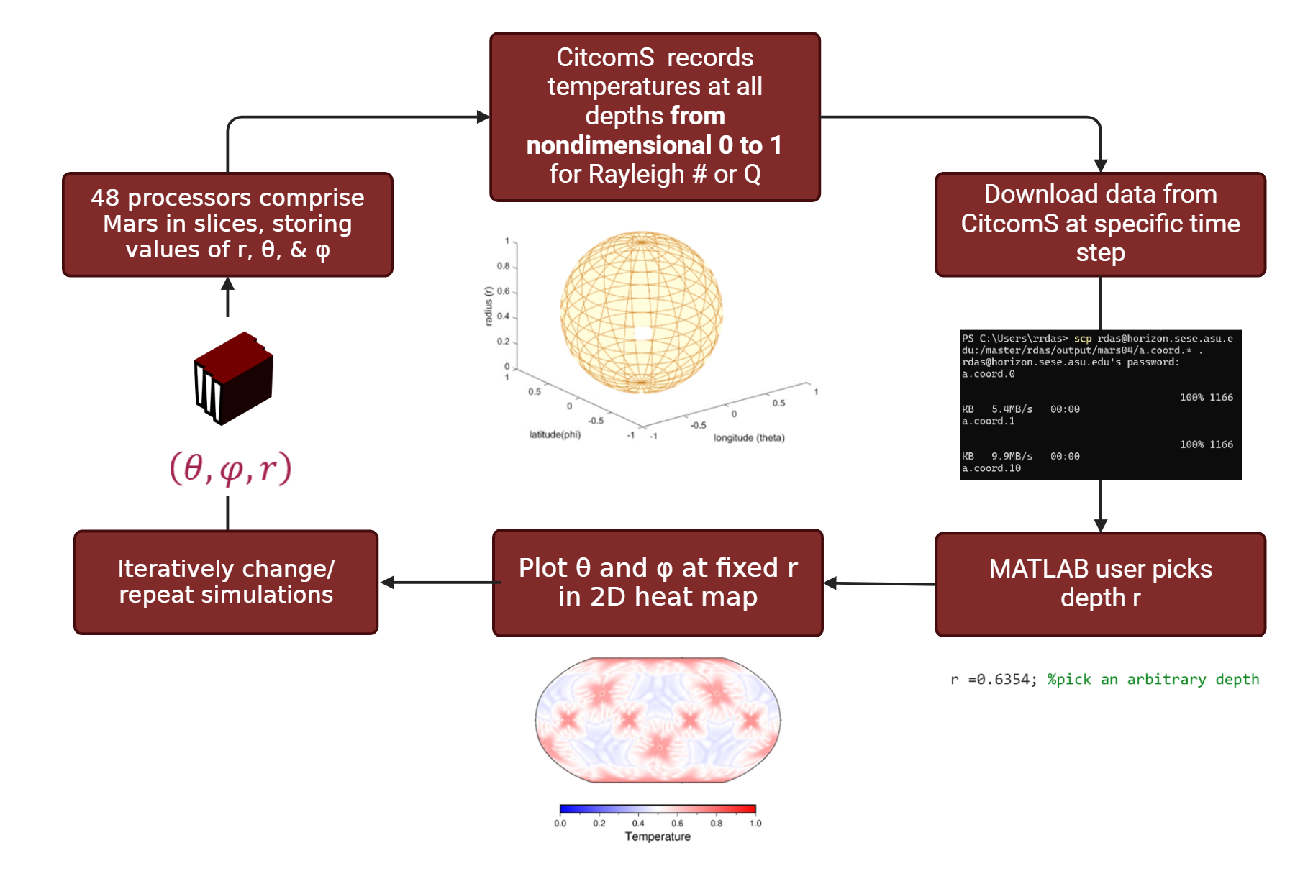
Simulation Pipeline

Slide 7
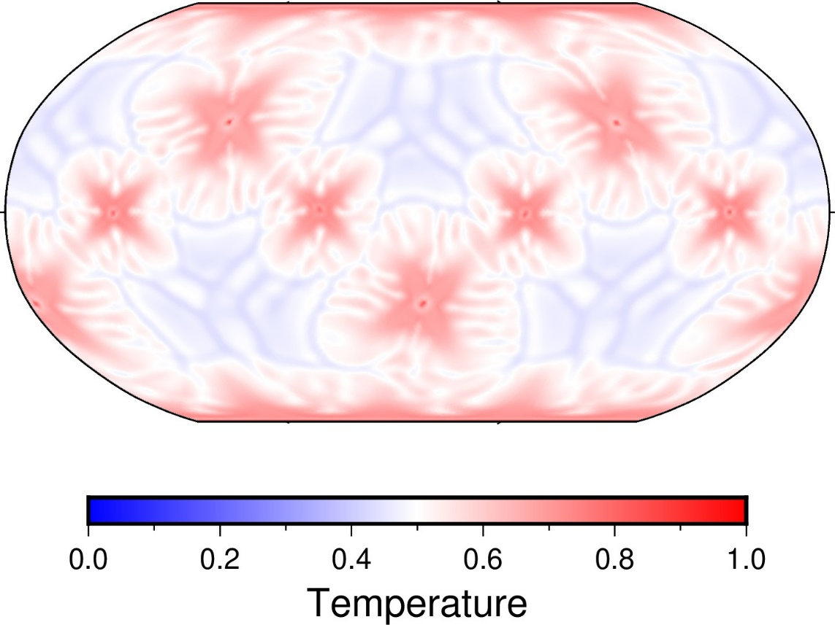
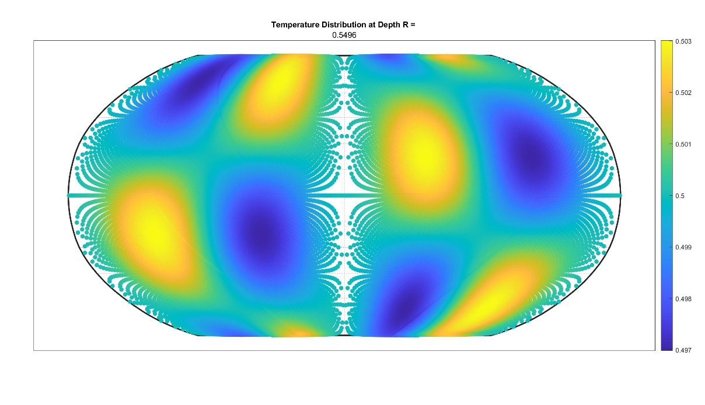
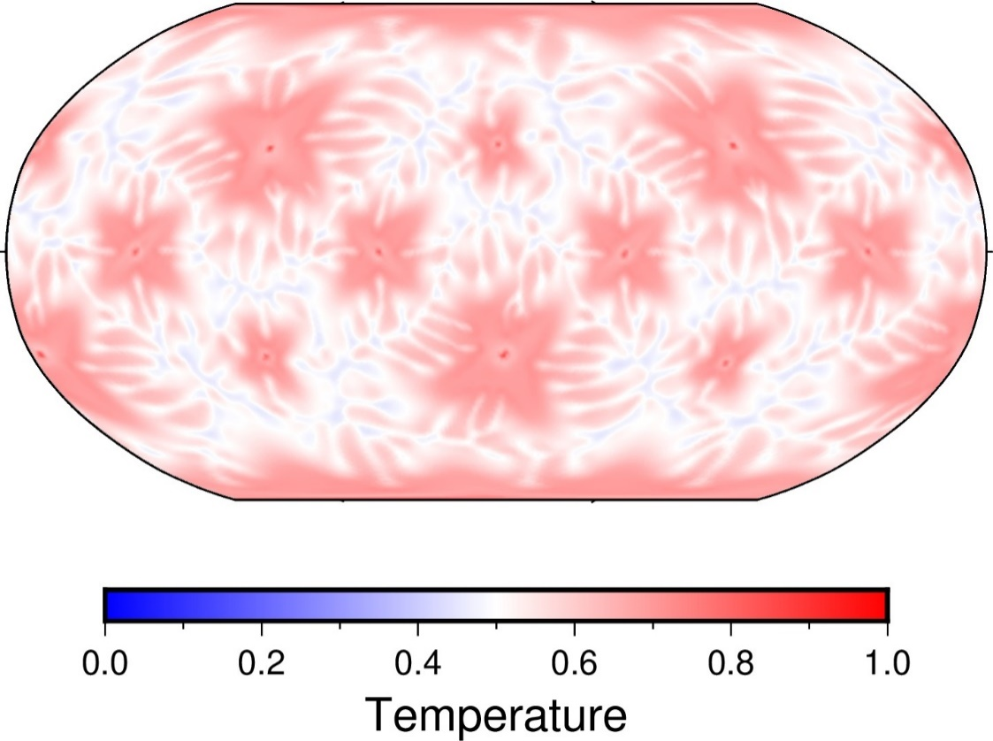
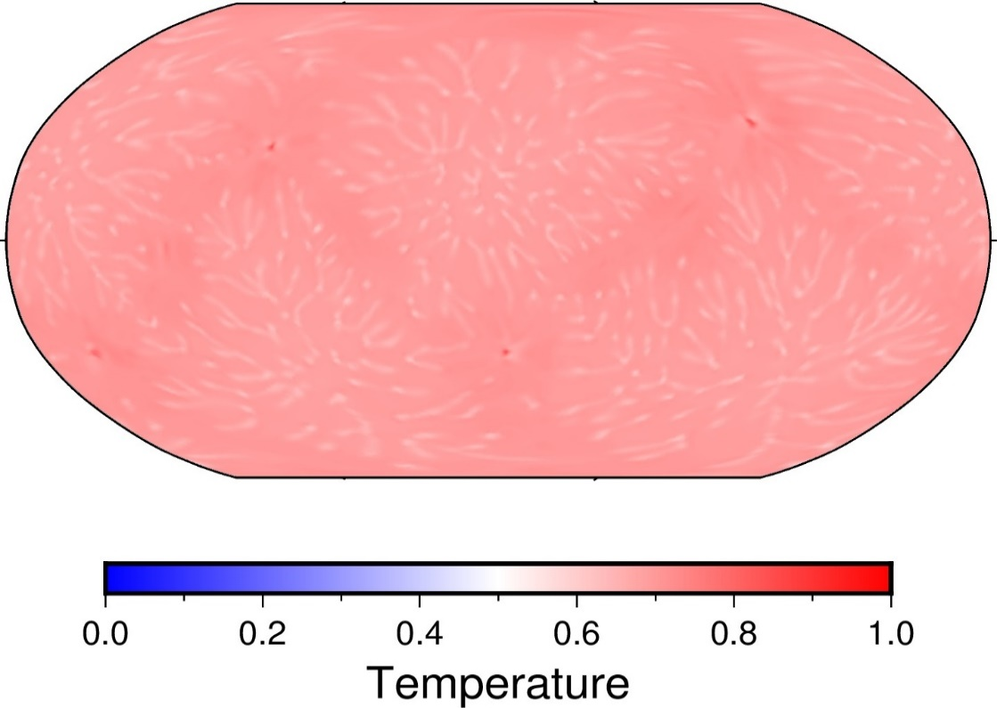
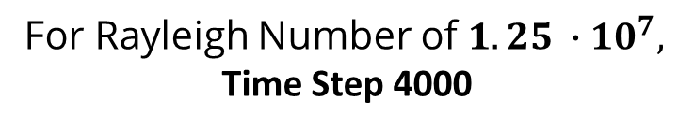
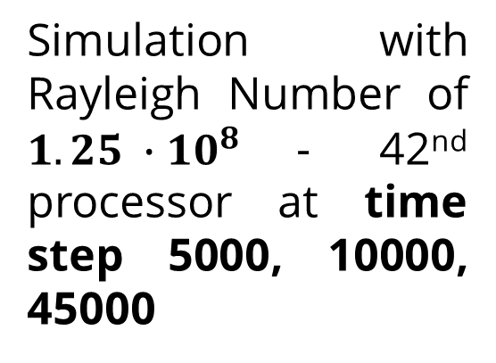
Results: 2D Temperature Maps
For Rayleigh Number of $1.25 ∙{10}^{7},$
Time Step 4000
Simulation with Rayleigh Number of $1.25 ∙{10}^{8}$- 42nd processor at time step 5000, 10000, 45000

Slide 8
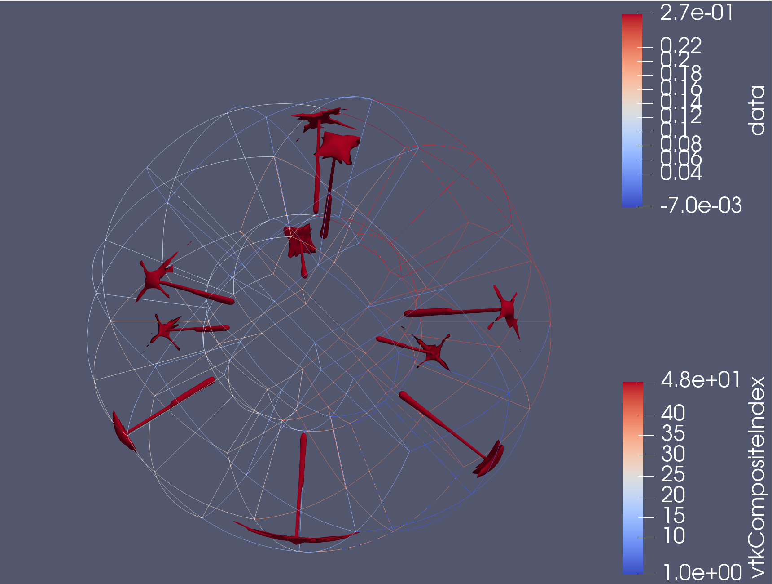
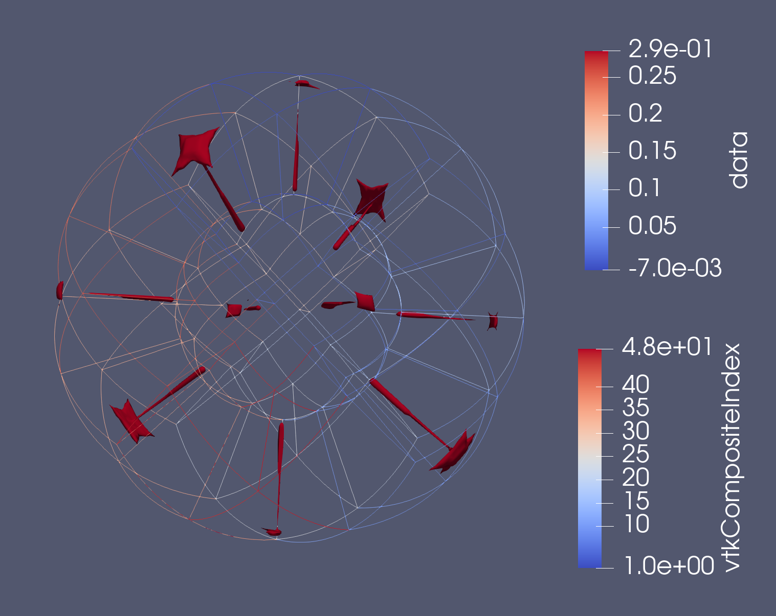
Results: Isosurface Models
Isosurface of 0.27 and 0.29 for internal heating rate of 50 vs. 75 at Rayleigh # of 1.25e9 & time step 4000

Slide 9
Discussion
Maps illustrate higher Rayleigh numbers correlate with higher number of mantle plumes
Theoretically, higher Rayleigh # lowers convection rate, creating more space for more mantle plumes to form
Unclear relationship between internal heating rate, number of mantle plumes, and Rayleigh numbrs
Theoretically, higher internal heating rate lowers viscosity, creating smaller plume sizes & space for more mantle plumes to form

Slide 10
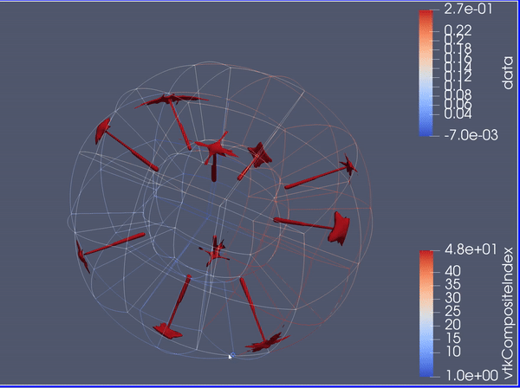
Next Steps
Run more simulations varying internal heating rates for each Rayleigh number
Create code for post processing in MATLAB to fill gaps in 2D maps
Source: Paraview & CitcomS

Slide 11
Acknowledgements
Thank you to Dr. Mingming Li, Desiree Crawl, Margaret Hufford, Arizona Space Grant, and Arizona State University’s School of Space & Exploration for the opportunity to research in this project!

